Slide 1

Lecture 4 Intermediate SQL
(Chapter 4)
Prof. Jihong Guan
Email: jhguan@tongji.edu.cn
School of Computer Science and Technology
Tongji University

Slide 2
Outline of the Course
Part 0: Overview
Ch1: Introduction
☞ Part 1 Relational Databases
Ch2: Relational model (data model, relational algebra)
Ch3&4: SQL(Structured Query Language)
Ch5: Advanced SQL
Part 2 Database Design
Ch6: Database design based on E-R model
Ch7: Relational database design
Part 3 Application Design & Development
Ch8: Complex data types
Ch9: Application development
Part 4 Big data analytics
Ch10: Big data
Ch11: Data analytics
Part 5 Data Storage & Indexing
Ch12: Physical storage system
Ch13: Data storage structure
Ch14: Indexing
Part 6 Query Processing & Optimization
Ch15: Query processing
Ch16: Query optimization
Part 7 Transaction Management
Ch17: Transactions
Ch18: Concurrency control
Ch19: Recovery system
Part 8 Parallel & Distributed Database
Ch20: Database system architecture
Ch21-23: Parallel & distributed storage, query processing & transaction processing
Part 9
DB Platform:OceanBase, MongoDB, Neo4J

Slide 3
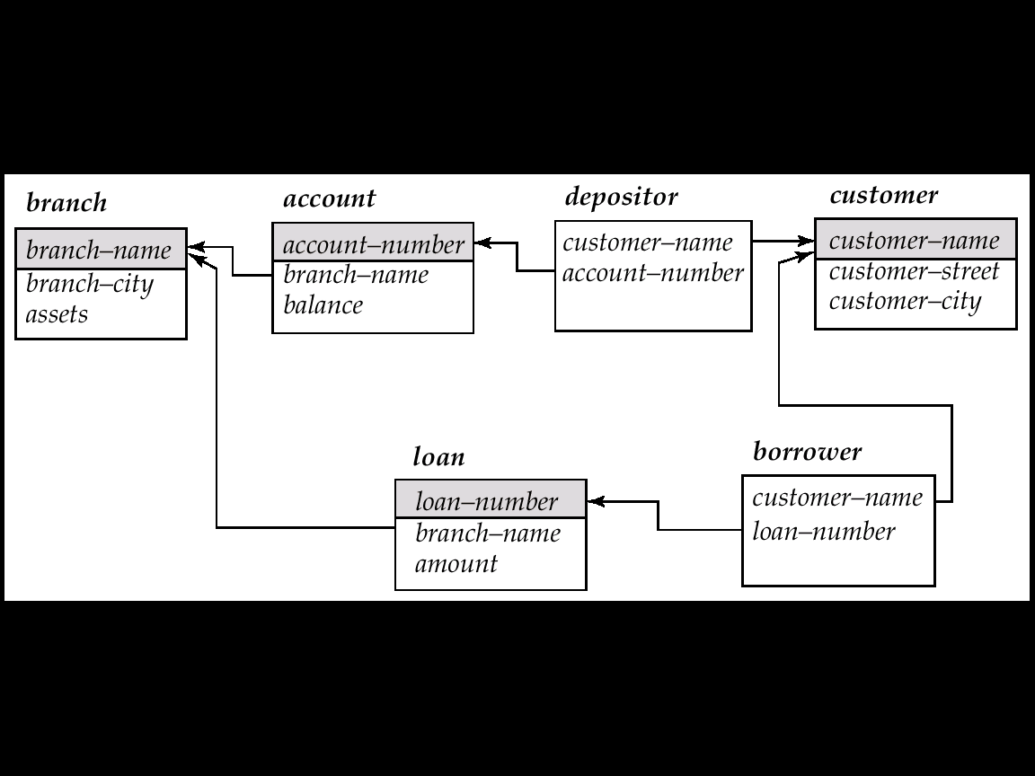
Schema Diagrams
branch (branch_name, branch_city, assets)
customer (customer_name, customer_street, customer_city)
account (account_number, branch_name, balance)
loan (loan_number, branch_name, amount)
depositor (customer_name, account_number)
borrower (customer_name, loan_number)
Banking database
Schema Diagram (模式图) for the banking enterprise

Slide 4
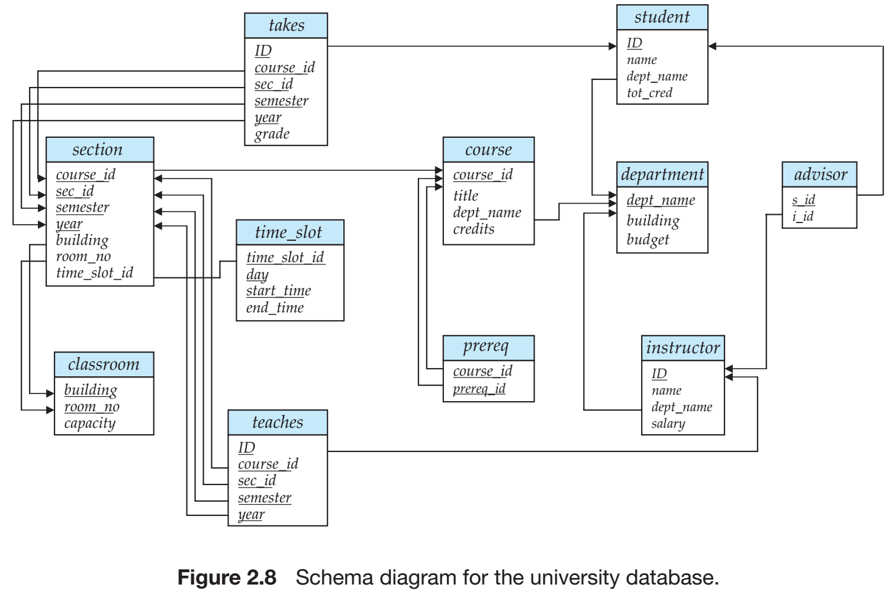
Schema diagram for the university database
Notes:
Referential integrity constraints other than foreign key constraints are not shown explicitly in schema diagrams. We will study a different diagrammatic representation called the entity-relationship diagram later, in Chapter 7. Entityrelationship diagrams let us represent several kinds of constraints, including general referential integrity constraints.

Slide 5
Outline
☞ Join Expressions
Views
Transactions
Integrity Constraints
Data Types in SQL
Index Definition in SQL
Authorization

Slide 6

The Natural Join
select $A_{1}$, $A_{2}$,…, $A_{n}$
from $r_{1}$ natural join $r_{2}$ natural join …natural join $r_{m}$
where P;
select name, course_id
from instructor natural join teaches;
select name, title
from instructor natural join teaches, course
where teaches.course_id = course.course_id;
Notes:
Notice that we do not repeat those attributes that appear in the schemas of both relations; rather they appear only once. Notice also the order in which the attributes are listed: first the attributes common to the schemas of both relations, second those attributes unique to the schema of the first relation, and finally, those attributes unique to the schema of the second relation.

Slide 7
Join Expressions
Join operations
Take two relations and return another relation as the results
Join type
Define how tuples in each relation that do not match any tuple in the other relation (based on the join condition) are treated
Join condition
Define which tuples in the two relations match, and what attributes are present in the result of the join
Join Types
Join Conditions
inner join
left outer join
right outer join
full outer join
natural
on <predicate>
using (A₁, A₂, ..., A_{n})
Notes:
In contrast, the join operations we studied earlier that don’t preserve nonmatched tuples are called inner join operations, to distinguish them from the outer-join operations.

Slide 8
Relations for Examples
Loan_number
Branch_name
amount
Customer_name
Loan_number
L-170
L-230
L-260
Downtown
Redwood
Perryridge
3000
4000
1700
Jones
Smith
Hayes
L-170
L-230
L-155
Relation loan
Relation borrower
Note: borrower information is missing for L-260 and loan information is missing for L-155
Notes:
outer join的用处就是显示那些暂时还没有值的记录。

Slide 9
Joined Relations – Examples
loan inner join borrower on loan.loan_number = borrower.loan_number
Loan_number
Branch_name
amount
Customer_name
Loan_number
L-170
L-230
Downtown
Redwood
3000
4000
Jones
Smith
L-170
L-230
loan left outer join borrower on loan.loan_number = borrower.loan_number
Loan_number
Branch_name
amount
Customer_name
Loan_number
L-170
L-230
L-260
Downtown
Redwood
Perryridge
3000
4000
1700
Jones
Smith
null
L-170
L-230
null

Slide 10
Joined Relations – Examples
loan natural inner join borrower
Loan_number
Branch_name
amount
Customer_name
L-170
L-230
Downtown
Redwood
3000
4000
Jones
Smith
loan natural right outer join borrower
Loan_number
Branch_name
amount
Customer_name
L-170
L-230
L-155
Downtown
Redwood
null
3000
4000
null
Jones
Smith
Hayes

Slide 11
Joined Relations – Examples
loan full outer join borrower using (loan_number)
Loan_number
Branch_name
amount
Customer_name
join-using = natural join
L-170
L-230
L-260
L-155
Downtown
Redwood
Perryridge
null
3000
4000
1700
null
Jones
Smith
null
Hayes
Find all customers who have either an account or a loan (but not both) at the bank:
select customer_name from (depositor natural full outer join borrower) where account_number is null or loan_number is null
Notes:
这里删除了重复属性是因为join-using就是自然连接。

Slide 12
Differences
join on/join using
on is predication
using is to specify attributes for natural join
join on/where
select name, title
from (instructor natural join teaches) join course using (course_id);
select *
from student left outer join takes on student.ID=takes.ID
select *
from student left outer join takes on true
where student.ID=takes.ID
Join on：结果中会出现ID也为NULL情况，如学生没有选课，就没有课的ID；on为join的一部分，一旦连接不成自动生成NULL
Where：因为join on true，断言的结论一直为真（没有空集），实际产生的是笛卡尔集合，不会出现NULL连接的情况，无法产生outer join的效果
Notes:
join 也是自然连接，using用来指代其需要连接的属性，即使相同但不在里面的属性不用来连接。
Join on：结果中会出现ID也为NULL的情况，比如学生没有选课，就没有课的ID。on为join的一部分，一旦连接不成自动生成NULL。
Where：因为上面join on true，因为断言的结论一直为真（就是没有空集），实际上产生的是笛卡尔集合，因此不会出现NULL连接的情况，无法产生outer join的效果。

Slide 13
Outline
Join Expressions
☞ Views
Transactions
Integrity Constraints
Data Types in SQL
Authorization

Slide 14
View and View Updates
Create a view of all loan data in relation loan, hiding the amount attribute
create view branch_loan as select branch_name, loan_number from loan
Add a new tuple to relation branch_loan
insert into branch_loan values (‘Perryridge’, ‘L-307’)
This insertion should be represented by the insertion of the tuple
(‘L-307’, ‘Perryridge’, null)
into the relation loan, loan (loan_number, branch_name, amount)

Slide 15
Update of a View (Cont.)
Updates on complex views are difficult or impossible to translate, and hence are disallowed
Most SQL implementations allow updates only on simple views (without aggregates) defined on a single relation.
In general, an SQL view is updatable if:
The select clause contains only attribute names of the relation, and does not have any expressions, aggregates, or distinct specification
Any attributes not listed in the select clause can be set to null
The from clause has only one relation
The query does not have a group by or having clause

Slide 16
Materialized Views (物化视图)
The relation of a view is stored
Will change if the actual relations used in the view definition change. The view is kept up-to-date
The aggregated result is likely to be much smaller than the large relations on which the view is defined; as a result the materialized view can be used to answer the query very quickly, avoiding reading the large underlying relations. Of course, the benefits to queries from the materialization of a view must be weighed against the storage costs and the added overhead for updates.
Materialized view maintenance
Real-time updates vs. periodic updates
Chapter 4 (Version 7)
Notes:
the aggregated result is likely to be much smaller than the large relations on which the view is defined; as a result the materialized view can be used to answer the query very quickly, avoiding reading the large underlying relations. Of course, the benefits to queries from the materialization of a view must be weighed against the storage costs and the added overhead for updates.

Slide 17
Outline
Join Expressions
Views
☞ Transactions
Integrity Constraints
Data Types in SQL
Authorization

Slide 18
Transactions
A transaction is a sequence of queries and update statements executed as a single unit (atomicity, 原子性)
Transactions are started implicitly and terminated by one of
commit [work]: makes all updates of the transaction permanent in the database
rollback [work]: undoes all updates performed by the transaction

Slide 19
Transactions (Cont.)
E.g., transfer of money from one account to another involves two steps: deduct from one account and credit to another
If one step succeeds and the other fails, database is in an inconsistent state
Either both steps should succeed or neither should
If any step of a transaction fails, all work done by the transaction can be undone by rollback work
Rollback of incomplete transactions is done automatically, in case of system failures

Slide 20
Transactions (Cont.)
In most database systems, each SQL statement that executes successfully is automatically committed
Each transaction consists of only a single statement
Automatic commit can be turned off, allowing multi-statement transactions, but depends on the database system
Another option in SQL:1999: enclose statements within
begin atomic … end

Slide 21
Outline
Join Expressions
Views
Transactions
☞ Integrity Constraints
Data Types in SQL
Index Definition in SQL
Authorization

Slide 22
Integrity Constraints
Integrity constraints guard against accidental damage to the database
by ensuring that authorized changes to the database do not result in a loss of data consistency
Types
Domain constraints
Not null constraint
Unique constraint
Referential integrity
…

Slide 23
Domain Constraints (域约束)
Domain constraints are the most elementary form of integrity constraint
New domains can be created from existing data types, e.g.,
create domain Dollars numeric(12, 2) create domain Pounds numeric(12, 2)
We cannot assign or compare a value of type Dollars to a value of type Pounds
The check clause in SQL-92 permits domains to be restricted
create domain hourly_wage numeric(5,2) constraint value_test check(value >= 6.00)
The domain has a constraint to ensure that the hourly_wage is greater than 6.00
The clause constraint value_test is optional but useful to indicate which constraint an update violates

Slide 24
Not Null Constraint
Declare branch_name for relation branch to be not null
branch_name char(15) not null
Declare the domain Dollars to be not null
create domain Dollars numeric(12,2) not null

Slide 25
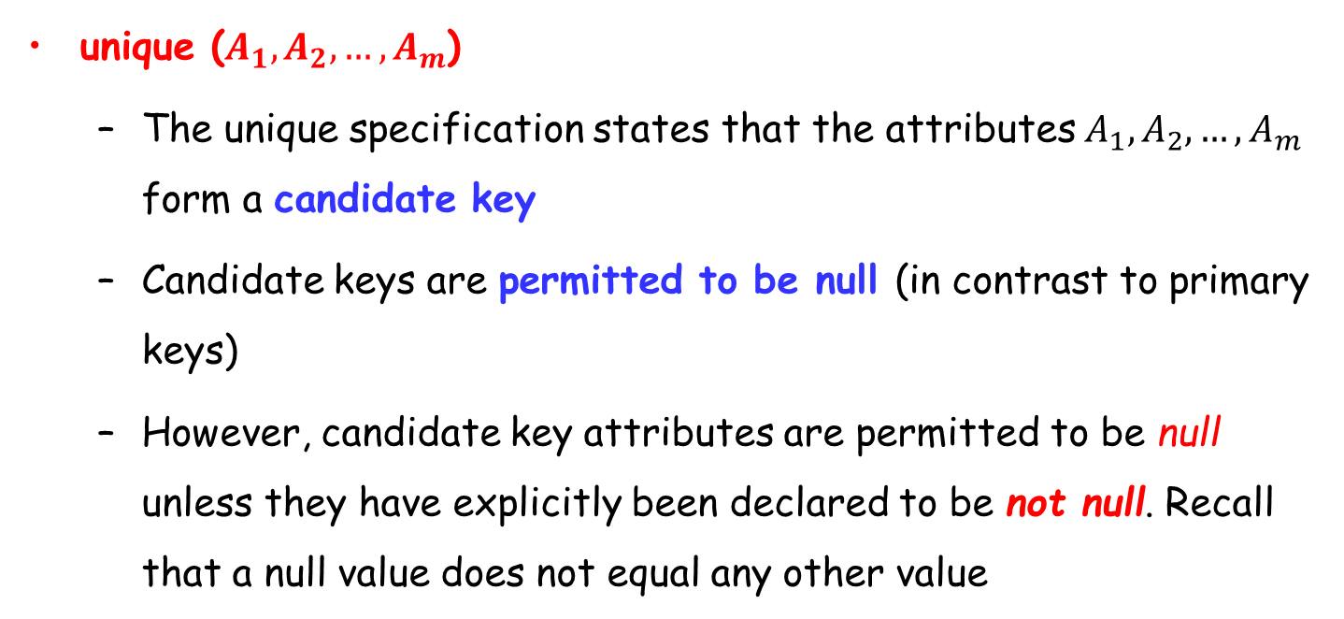
Unique Constraint
unique ($A_{1},A_{2},…,A_{m}$)
The unique specification states that the attributes $A_{1},A_{2},…,A_{m}$ form a candidate key
Candidate keys are permitted to be null (in contrast to primary keys)
However, candidate key attributes are permitted to be null unless they have explicitly been declared to be not null. Recall that a null value does not equal any other value
Notes:
However, candidate key attributes are permitted to be null unless they have explicitly been declared to be not null. Recall that a null value does not equal any other value

Slide 26
The check Clause
check (P), where P is a predicate
E.g., declare branch_name as the primary key for relation branch and ensure that the values of assets are non-negative
create table branch (branch_name char(15), branch_city char(30), assets integer, primary key (branch_name), check (assets >= 0))

Slide 27
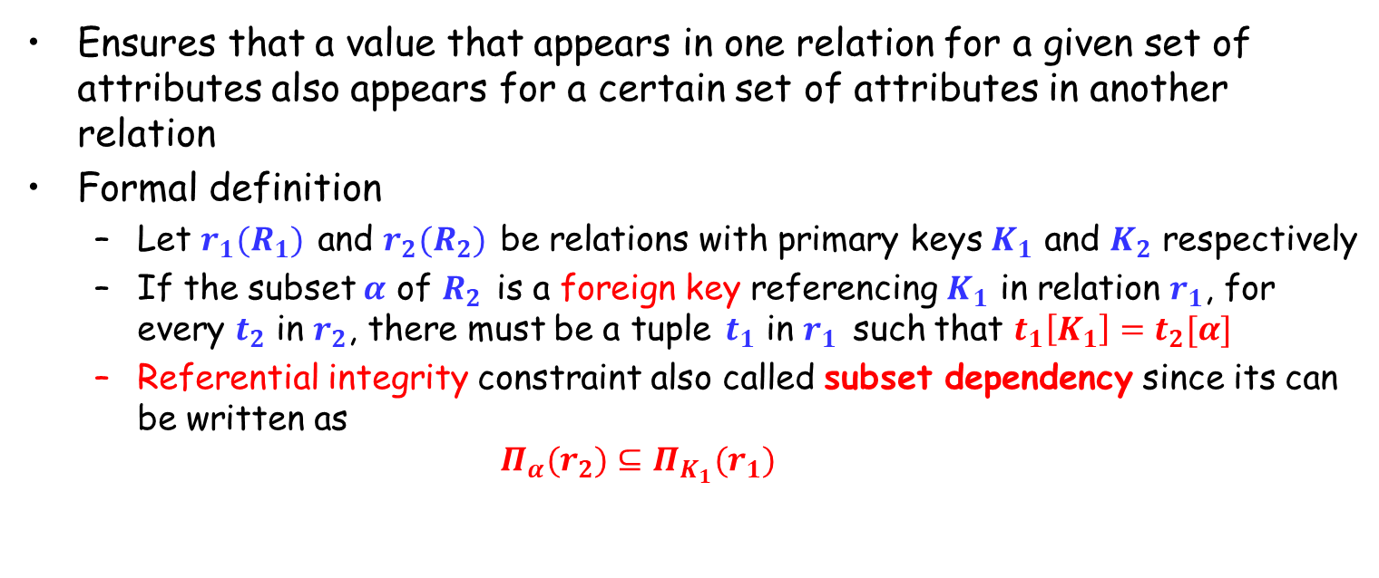
Referential Integrity (参照完整性)
Ensures that a value that appears in one relation for a given set of attributes also appears for a certain set of attributes in another relation
Formal definition
Let $r_{1}(R_{1})$ and $r_{2}(R_{2})$ be relations with primary keys $K_{1}$ and $K_{2}$ respectively
If the subset $α$ of $R_{2}$ is a foreign key referencing $K_{1}$ in relation $r_{1}$, for every $t_{2}$ in $r_{2}$, there must be a tuple $t_{1}$ in $r_{1}$ such that $t_{1}\left[K_{1}\right]=t_{2}[α]$
Referential integrity constraint also called subset dependency since its can be written as $Π_{α}(r_{2})⊆Π_{K_{1}}(r_{1})$

Slide 28
Integrity Constraint Violation in Transactions
create table person ( ID char(10), name char(40), spouse char(10), primary key ID, foreign key spouse references person)
That is, the constraint says that the spouse attribute must contain a name that is present in the person table.
Suppose we wish to note the fact that John and Mary are married to each other by inserting two tuples, one for John and one for Mary, in the above relation, with the spouse attributes set to Mary and John, respectively. The insertion of the first tuple would violate the foreign-key constraint, regardless of which of the two tuples is inserted first. After the second tuple is inserted the foreign-key constraint would hold again.
How to handle such situations？
Notes:
suppose we have a relation person with primary key name, and an attribute spouse, and suppose that spouse is a foreign key on person. That is, the constraint says that the spouse attribute must contain a name that is present in the person table. Suppose we wish to note the fact that John and Mary are married to each other by inserting two tuples, one for John and one for Mary, in the above relation, with the spouse attributes set to Mary and John, respectively. The insertion of the first tuple would violate the foreign-key constraint, regardless of which of the two tuples is inserted first. After the second tuple is inserted the foreign-key constraint would hold again. To handle such situations, the SQL standard allows a clause initially deferred to be added to a constraint specification; the constraint would then be checked at the end of a transaction, and not at intermediate steps. A constraint can alternatively be specified as deferrable, which means it is checked immediately by default, but can be deferred when desired. For constraints declared as deferrable, executing a statement set constraints constraint-list deferred as part of a transaction causes the checking of the specified constraints to be deferred to the end of that transaction

Slide 29
Integrity Constraint Violation in Transactions
To handle such situations, the SQL standard allows a clause initially deferred to be added to a constraint specification; the constraint would then be checked at the end of a transaction, and not at intermediate steps.
A constraint can alternatively be specified as deferrable, which means it is checked immediately by default, but can be deferred when desired. For constraints declared as deferrable, executing a statement set constraints constraint-list deferred as part of a transaction causes the checking of the specified constraints to be deferred to the end of that transaction
How to insert a tuple without causing constraint violation?
Set spouse to null initially, update after inserting all persons (not possible if spouse attributes declared to be not null)
OR defer constraint checking
set constraints constraint_list deferred
Notes:
suppose we have a relation person with primary key name, and an attribute spouse, and suppose that spouse is a foreign key on person. That is, the constraint says that the spouse attribute must contain a name that is present in the person table. Suppose we wish to note the fact that John and Mary are married to each other by inserting two tuples, one for John and one for Mary, in the above relation, with the spouse attributes set to Mary and John, respectively. The insertion of the first tuple would violate the foreign-key constraint, regardless of which of the two tuples is inserted first. After the second tuple is inserted the foreign-key constraint would hold again. To handle such situations, the SQL standard allows a clause initially deferred to be added to a constraint specification; the constraint would then be checked at the end of a transaction, and not at intermediate steps. A constraint can alternatively be specified as deferrable, which means it is checked immediately by default, but can be deferred when desired. For constraints declared as deferrable, executing a statement set constraints constraint-list deferred as part of a transaction causes the checking of the specified constraints to be deferred to the end of that transaction

Slide 30
Complex Check Clauses
check (time_slot_id in (select time_slot_id from time_slot))
Can we use a foreign key here?
Every section has at least one instructor teaching the section
how to write this?
check ((course_id, sec_id, semester, year) in (select course_id, sec_id, semester, year from takes))
Unfortunately: subquery in check clause or create assertion (断言) is not supported by many database systems
Alternative: triggers (later)
Notes:
Another natural constraint on our university schema would be to require that every section has at least one instructor teaching the section. In an attempt to enforce this, we may try to declare that the attributes (course id, sec id, semester, year) of the section relation form a foreign key referencing the corresponding attributes of the teaches relation. Unfortunately, these attributes do not form a candidate key of the relation teaches. A check constraint similar to that for the time slot attribute can be used to enforce this constraint, if check constraints with subqueries were supported by a database system.

Slide 31
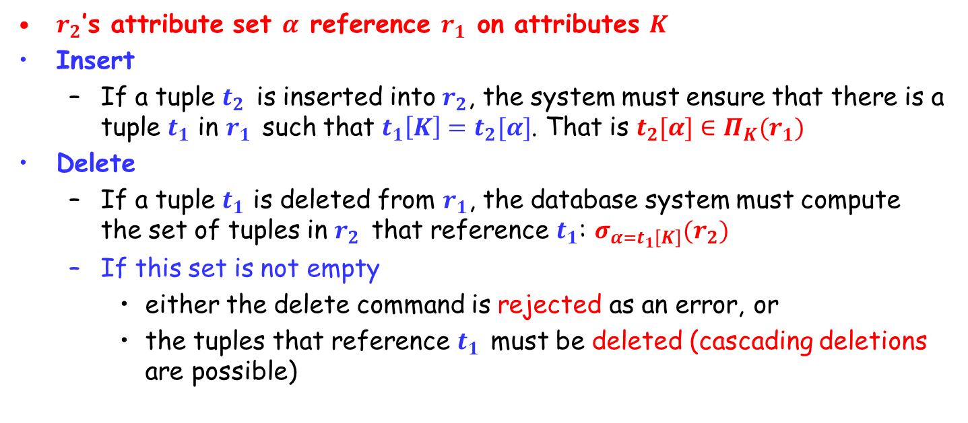
Database Modification
$r_{2}$’s attribute set $α$ reference $r_{1}$ on attributes $K$
Insert
If a tuple $t_{2}$ is inserted into $r_{2}$, the system must ensure that there is a tuple $t_{1}$ in $r_{1}$ such that $t_{1}\left[K\right]=t_{2}[α]$. That is $t_{2}[α]∈Π_{K}(r_{1})$
Delete
If a tuple $t_{1}$ is deleted from $r_{1}$, the database system must compute the set of tuples in $r_{2}$ that reference $t_{1}$: $σ_{α=t_{1}\left[K\right]}(r_{2})$
If this set is not empty
either the delete command is rejected as an error, or
the tuples that reference $t_{1}$ must be deleted (cascading deletions are possible)

Slide 32
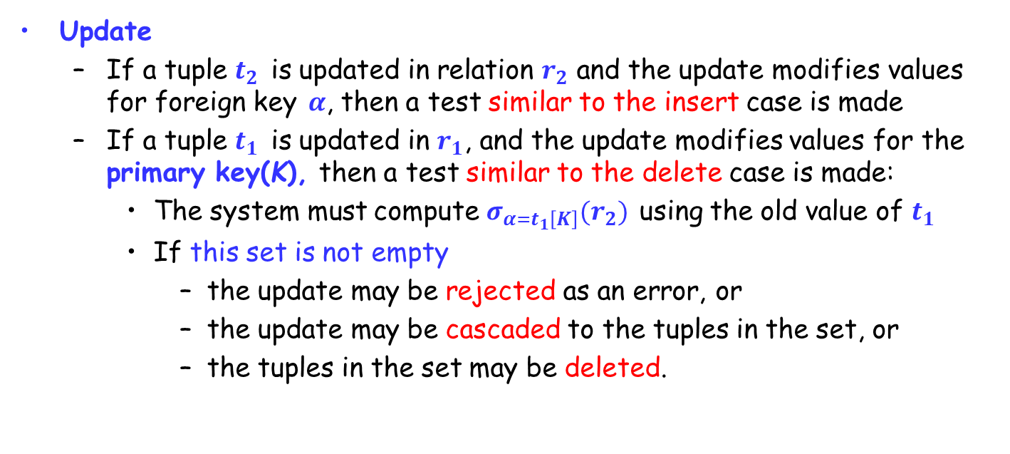
Database Modification (Cont.)
Update
If a tuple $t_{2}$ is updated in relation $r_{2}$ and the update modifies values for foreign key $α$, then a test similar to the insert case is made
If a tuple $t_{1}$ is updated in $r_{1}$, and the update modifies values for the primary key(K), then a test similar to the delete case is made:
The system must compute $σ_{α=t_{1}\left[K\right]}(r_{2})$ using the old value of $t_{1}$
If this set is not empty
the update may be rejected as an error, or
the update may be cascaded to the tuples in the set, or
the tuples in the set may be deleted.

Slide 33
Referential Integrity in SQL
Primary, candidate, foreign keys can be specified as part of the SQL create table statement:
The primary key clause
The unique key clause
The foreign key clause
By default, a foreign key references the primary key attributes of the referenced table
foreign key (account_number) references account
Short form for specifying a single column as foreign key
account_number char (10) references account

Slide 34
Referential Integrity in SQL – Example
create table customer (customer_name char(20), customer_street char(30), customer_city char(30), primary key (customer_name))；
create table branch (branch_name char(15), branch_city char(30), assets integer, primary key (branch_name))；
create table account (account_number char(10), branch_name char(15), balance integer, primary key (account_number), foreign key (branch_name) references branch)；
create table depositor (customer_name char(20), account_number char(10), primary key (customer_name, account_number), foreign key (account_number) references account, foreign key (customer_name) references customer)；

Slide 35
Cascading Actions in Referential Integrity
create table course ( course_id char(5) primary key, title varchar(20), dept_name varchar(20) references department )；
create table course ( … dept_name varchar(20), foreign key (dept_name) references department on delete cascade on update cascade, … )；
Due to the on delete cascade clauses, if a delete of a tuple in department results in referential-integrity constraint violation, the delete “cascades” to the course relation, the tuples that refer to the department that should be deleted
Cascading updates are similar
Notes:
Because of the clause on delete cascade associated with the foreign-key declaration, if a delete of a tuple in department results in this referential-integrity constraint being violated, the system does not reject the delete. Instead, the delete “cascades” to the course relation, deleting the tuple that refers to the department that was deleted. Similarly, the system does not reject an update to a field referenced by the constraint if it violates the constraint; instead, the system updates the field dept name in the referencing tuples in course to the new value as well. SQL also allows the foreign key clause to specify actions other than cascade, if the constraint is violated, the referencing field (here, dept name) can be set to null (by using set null in place of cascade), or to the default value for the domain (by using set default).

Slide 36
Cascading Actions in SQL (Cont.)
If there is a chain of foreign-key dependencies across multiple relations, with on delete cascade specified for each dependency, a deletion or update at one end of the chain can propagate across the entire chain
Referential integrity is only checked at the end of a transaction
Intermediate steps are allowed to violate referential integrity provided later steps remove the violation
Otherwise it would be impossible to create some database states, e.g. insert two tuples whose foreign keys point to each other
E.g. spouse attribute of relation married_person(name, address, spouse)
…

Slide 37
Referential Integrity in SQL (Cont.)
Alternative to cascading
on delete set null
on delete set default
Null values in foreign key attributes complicate SQL referential integrity semantics
if any attribute of a foreign key is null, the tuple is defined to satisfy the foreign key constraint
Notes:
外键属性中的 Null 值会使 SQL 引用完整性语义复杂化, 最好避免使用
用 not null 来限制

Slide 38
Assertions (断言)
An assertion is a predicate expressing a condition that we wish the database always to satisfy
An assertion in SQL takes the form
create assertion <assertion-name> check <predicate>
When an assertion is made, the system tests it for validity, and tests it again on every update that may violate the assertion
This testing may introduce a significant amount of overhead; hence assertions should be used with great care

Slide 39
Example
The sum of all loan amounts for each branch must be less than the sum of all account balances at the branch
create assertion sum_constraint check (not exists
(select *
from branch where (select sum(amount)
from loan where loan.branch_name = branch.branch_name) >= (select sum(balance)
from account where loan.branch_name = branch.branch_name)))

Slide 40
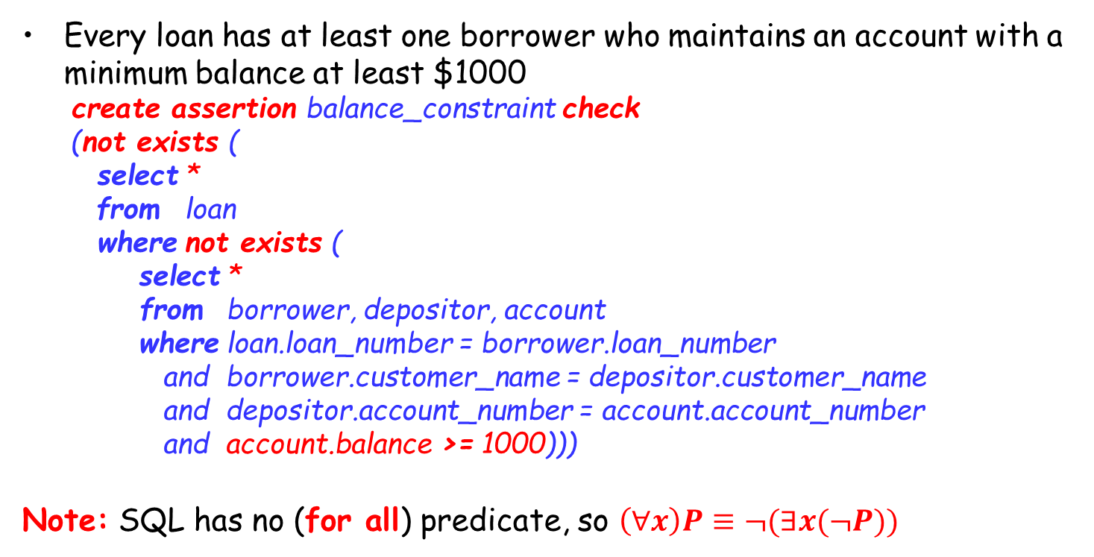
Example
Every loan has at least one borrower who maintains an account with a minimum balance at least $1000
create assertion balance_constraint check (not exists ( select *
from loan where not exists ( select * from borrower, depositor, account where loan.loan_number = borrower.loan_number and borrower.customer_name = depositor.customer_name and depositor.account_number = account.account_number and account.balance >= 1000)))
Note: SQL has no (for all) predicate, so $\left(∀x\right)P≡¬(∃x(¬P))$

Slide 41
Outline
Join Expressions
Views
Transactions
Integrity Constraints
☞ Data Types in SQL
Index Definition in SQL
Authorization

Slide 42
Built-in Data Types in SQL
date: dates, containing a (4 digit) year, month and day
E.g., date ‘2005-07-27’
time: time of day, in hours, minutes and seconds
E.g., time ‘09:00:30’ time ‘09:00:30.75’
timestamp: date plus time of day
E.g., timestamp ‘2005-07-27 09:00:30.75’
timestamp (p) specifies the number of digits after the decimal point
interval: period of time
E.g., interval ‘1’ day
Subtracting a date/time/timestamp value from another gives an interval value
Interval values can be added to date/time/timestamp values
Notes:
built-in data types supported in SQL, such as integer types, real types, and character types. There are additional built-in data types supported by SQL. 75’为时区timezone

Slide 43
Built-in Data Types in SQL (Cont.)
Can extract values of individual fields from date/time/timestamp, e.g.,
extract (year from current_date)
Can cast string types to date/time/timestamp, e.g.,
cast <string-valued-expression> as date
cast <string-valued-expression> as time

Slide 44
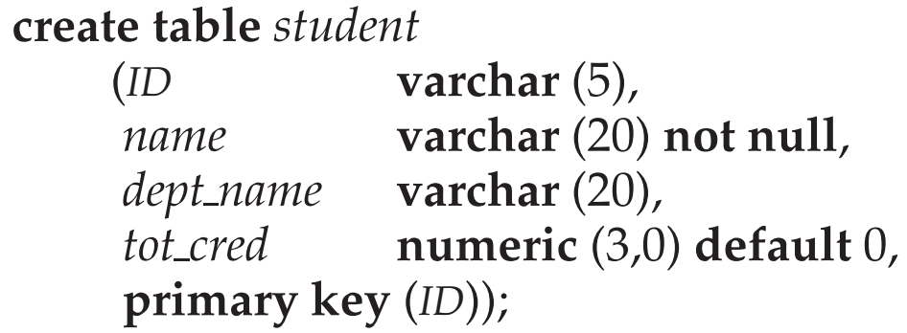
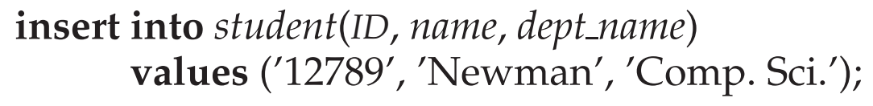
Default Values
A default value to be specified for an attribute
How an insertion can omit the value for the tot_cred attribute?

Slide 45
Large-Object Types
Large objects (photos, videos, CAD files, etc.) are stored as a large object
blob: binary large object - object is a large collection of uninterpreted binary data. The interpretation is left to an application outside of the database system
clob: character large object - object is a large collection of character data
E.g. book_review clob(10KB)
image blob (10MB)
movie blob(2GB)
When a query returns a large object, a locator (pointer) is returned rather than the large object itself

Slide 46
User-Defined Types
Create type construct in SQL creates user-defined type
create type Dollars as numeric (12,2) [final]
Create domain construct in SQL-92 creates user-defined domain types
create domain person_name char(20) not null
Types and domains are similar. Domains can have constraints, such as not null/default values, specified on them
create domain degree_level varchar(10) constraint degree_level_test check (value in (’Bachelors’, ’Masters’, ’Doctorate’));
Notes:
12 digits, two of which are placed after the decimal point Final表示变量类型不能改变。
It is possible for several attributes to have the same data type. An attempt to assign a value of type Dollars to a variable of type Pounds results in a compile-time error, although both are of the same numeric type. Such an assignment is likely to be due to a programmer error, where the programmer forgot about the differences in currency. Declaring different types for different currencies helps catch such errors.

Slide 47
Outline
Join Expressions
Views
Transactions
Integrity Constraints
Data Types in SQL
Index Definition in SQL
Authorization

Slide 48
Index Creation
Many queries reference only a small proportion of the records in a table.
It is inefficient for the system to read every record to find a record with particular value
An index on an attribute of a relation is a data structure that allows the database system to find those tuples in the relation that have a specified value for that attribute efficiently, without scanning through all the tuples of the relation.
We create an index with the create index command
create index <name> on <relation-name> (attribute);

Slide 49
Index Creation
create table student (ID varchar (5), name varchar (20) not null, dept_name varchar (20), tot_cred numeric (3,0) default 0, primary key (ID));
create index studentID_index on student(ID);
Indices are data structures used to speed up access to records with specified values for index attributes
select * from student where ID = ‘12345’
Can be executed by using the index to find the required record, without looking at all records of relation student
More details on index in Chapter 14 (Version 7)(Binary tree, B+ tree, B tree, Hash…)

Slide 50
Outline
Join Expressions
Views
Transactions
Integrity Constraints
Data Types in SQL
Index Definition in SQL
☞ Authorization

Slide 51
Security
Security - protection from malicious attempts to steal or modify data
Database system level
Authentication and Authorization mechanisms to allow specific users access only to required data
Operating system level
Operating system super-users can do anything they want to the database
Network level: must use encryption to prevent
Eavesdropping (窃听，unauthorized reading of messages)
Masquerading (冒充，pretending to be an authorized user or sending messages supposedly from authorized users)
Notes:
Eavesdropping ['iːvz.drɒp]：偷听。
Supposedly ：假冒

Slide 52
Security (Cont.)
Security protection from malicious attempts to steal or modify data
Physical level
Physical access to computers allows destruction of data by intruders, and traditional lock-and-key security is needed
Computers must also be protected from floods, fire, etc. (cf. Chapter 19 Recovery)
Human level
Users must be screened to ensure that an authorized users do not give access to intruders
Users should be trained on password selection and secrecy
Notes:
用户必须经过筛选

Slide 53
Authorization
Forms of authorization on parts of the database
Read authorization - allows reading, but not modification of data.
Insert authorization - allows insertion of new data, but not modification of existing data.
Update authorization - allows modification, but not deletion of data.
Delete authorization - allows deletion of data

Slide 54
Authorization (Cont.)
Forms of authorization to modify the database schema
Index authorization - allows creation and deletion of indices
Resources authorization - allows creation of new relations
Alteration authorization - allows addition or deletion of attributes in a relation
Drop authorization - allows deletion of relations

Slide 55
Authorization on Views
Users can have the authorization on views without any authorization on the relations used in the view definition
Ability of views to hide data serves both to simplify usage of the system and to enhance security by allowing users access only to data they need for their job
A combination of relational-level security and view-level security can be used to limit a users’ precisely access to the data that they need

Slide 56
View Example
Suppose a bank clerk Deny needs to know the names of the customers of each branch, but is not authorized to see specific loan information
Deny direct access to the loan relation, but grant access to the view cust_loan, which consists only of the names of customers and the branches at which they have a loan
The cust_loan view is defined in SQL as follows:
create view cust_loan as select branch_name, customer_name from borrower, loan where borrower.loan_number = loan.loan_number

Slide 57
View Example (Cont.)
The clerk is authorized to see the result of the query:
select * from cust_loan
When the query processor translates the result into a query on the actual relations in the database, we obtain a query on borrower and loan
Authorization must be checked on the clerk’s query before query processing replaces a view by the definition of the view

Slide 58
Authorization on Views
Creation of a view does not require resources authorization since no real relation is being created
The creator of a view gets only those privileges that provide no additional authorization beyond that he already had
E.g., if creator of view cust_loan had only read authorization on borrower and loan, he gets only read authorization on cust_loan

Slide 59
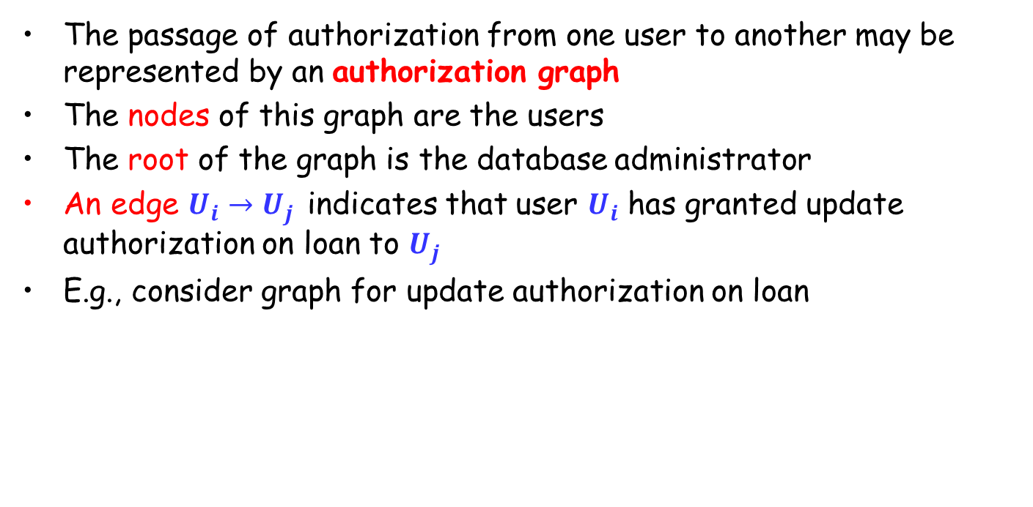
Transfer/Granting of Privileges
The passage of authorization from one user to another may be represented by an authorization graph
The nodes of this graph are the users
The root of the graph is the database administrator
An edge $U_{i}→U_{j}$ indicates that user $U_{i}$ has granted update authorization on loan to $U_{j}$
E.g., consider graph for update authorization on loan
U₁
U₄
DBA
U₂
U₅
U₃

Slide 60
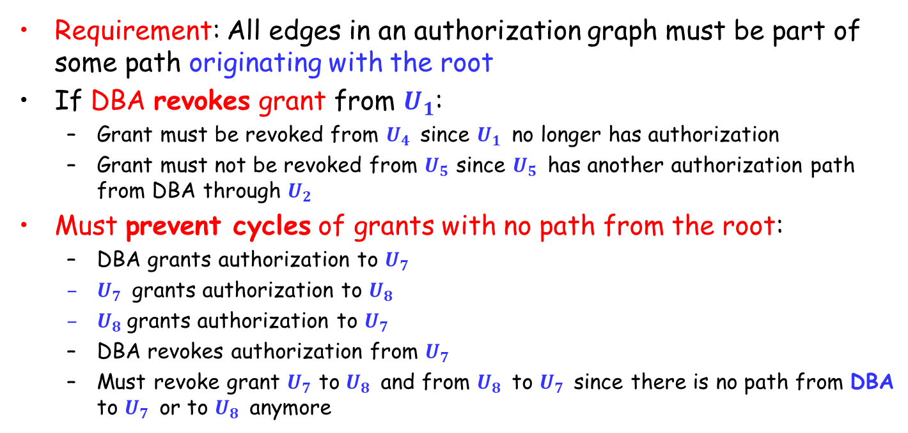
Authorization Grant Graph
Requirement: All edges in an authorization graph must be part of some path originating with the root
If DBA revokes grant from $U_{1}$:
Grant must be revoked from $U_{4}$ since $U_{1}$ no longer has authorization
Grant must not be revoked from $U_{5}$ since $U_{5}$ has another authorization path from DBA through $U_{2}$
Must prevent cycles of grants with no path from the root:
DBA grants authorization to $U_{7}$
$U_{7}$ grants authorization to $U_{8}$
$U_{8}$grants authorization to $U_{7}$
DBA revokes authorization from $U_{7}$
Must revoke grant $U_{7}$ to $U_{8}$ and from $U_{8}$ to $U_{7}$ since there is no path from DBA to $U_{7}$ or to $U_{8}$ anymore

Slide 61
Security Specification in SQL
The grant statement is used to confer authorization
grant <privilege list>
on <relation name or view name>
to <user list>
<user list> is:
a user-id
public, which allows all valid users the privilege granted
A role (more on this later)
Granting a privilege on a view does not imply granting any privileges on the underlying relations
The grantor of the privilege must already hold the privilege on the specified item

Slide 62
Privileges in SQL
select: allows read access to relation, or the ability to query using the view
E.g., grant select on branch to U₁, U₂, U₃
insert: the ability to insert tuples
update: the ability to update using the SQL update statement
delete: the ability to delete tuples
references: ability to declare foreign keys when creating relations
usage: In SQL-92, authorizes a user to use a specified domain
all privileges: used as a short form for all the allowable privileges

Slide 63
Privilege to Grant Privileges
with grant option
Allow a user who is granted a privilege to pass the privilege on to other users
E.g., give U₁ the select privilege on branch and allows U₁ to grant this privilege to others
grant select on branch to U₁ with grant option

Slide 64
Roles (角色)
Roles permit common privileges for a class of users can be specified just once by creating a corresponding “role”
Privileges can be granted to or revoked from roles, just like user
Roles can be assigned to users, and even to other roles
create role teller create role manager
grant select on branch to teller grant update (balance) on account to teller grant all privileges on account to manager grant teller to manager grant teller to alice, bob grant manager to avi

Slide 65
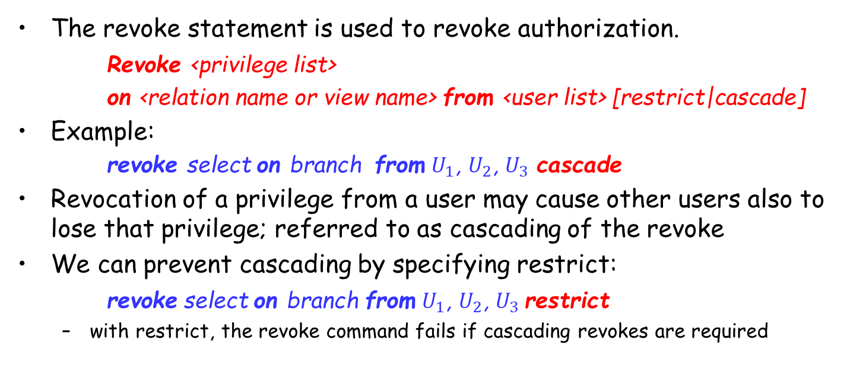
Revoking Authorization in SQL
The revoke statement is used to revoke authorization.
Revoke <privilege list>
on <relation name or view name> from <user list> [restrict|cascade]
Example:
revoke select on branch from $U_{1}$, $U_{2}$, $U_{3}$ cascade
Revocation of a privilege from a user may cause other users also to lose that privilege; referred to as cascading of the revoke
We can prevent cascading by specifying restrict:
revoke select on branch from $U_{1}$, $U_{2}$, $U_{3}$restrict
with restrict, the revoke command fails if cascading revokes are required

Slide 66
Revoking Authorization in SQL (Cont.)
<privilege-list> may be all to revoke all privileges the revoke may hold
If <revoke-list> includes public, all users lose the privilege except those granted it explicitly
If the same privilege was granted twice to the same user by different grantees, the user may retain the privilege after the revocation
All privileges that depend on the privilege being revoked are also revoked
Notes:
If <revokee-list> includes public all users lose the privilege except those granted it explicitly？

Slide 67
Limitations of SQL Authorization
SQL does not support authorization at a tuple level
E.g., we cannot restrict students to see only their own grades
With the growth in Web access to databases, database accesses come primarily from application servers
End users don't have database user ids, they are all mapped to the same database user id
The task of authorization in such cases falls on the application program, with no support from SQL
Benefit: fine-grained authorizations, such as to individual tuples, can be implemented by the application.
Drawbacks
Authorization must be done in application code, and may be dispersed all over the application
Checking for the authorization loopholes (漏洞) becomes very difficult since it requires reading large amounts of application code
Notes:
Loophole：漏洞。

Slide 68
Audit Trails (审计追踪)
An audit trail is a log of all changes (inserts / deletes / updates) to the database along with information such as
which user performed the change
when the change was performed
Used to track erroneous/fraudulent(欺骗性的) updates
Can be implemented using triggers, but many database systems provide direct support
Notes:
Audit Trails: 审计追踪

Slide 69
Encryption
Data may be encrypted when database authorization provisions do not offer sufficient protection
Properties of good encryption technique:
Relatively simple for authorized users to encrypt and decrypt data
Encryption scheme depends not on the secrecy of the algorithm but on the secrecy of a parameter of the algorithm called the encryption key (密钥)
Extremely difficult for an intruder to determine the encryption key
Notes:
Provisions: 规定
Encryption scheme: 加密策略
Secrecy: 保密性

Slide 70
Encryption (Cont.)
Data Encryption Standard (DES)
Substitutes characters and rearranges their order on the basis of an encryption key which is provided to authorized users via a secure mechanism
Scheme is no more secure than the key transmission mechanism since the key has to be shared
Advanced Encryption Standard (AES)
a new standard replacing DES, and is based on the Rijndael algorithm, but is also dependent on shared secret keys
Notes:
Rijndael: 分组密码

Slide 71
Encryption (Cont.)
Public-key encryption
each user has two keys:
public key – used to encrypt data, but cannot be used to decrypt data
private key -- used to decrypt data
Encryption scheme is impossible or extremely hard to decrypt data given only the public key
The RSA public-key encryption scheme is based on the hardness of factoring a very large number (100's of digits) into its prime components.

Slide 72
Authentication
Password-based authentication is widely used, but is susceptible to sniffing on a network
Challenge-response systems avoid transmission of passwords
DB sends a (randomly generated) challenge string to user
User encrypts string and returns result
DB verifies identity by decrypting result
Can use public-key encryption system by DB sending a message encrypted using user’s public key, and user decrypting and sending the message back

Slide 73
Authentication (cont.)
Digital signatures are used to verify authenticity of data
E.g. use private key (in reverse) to encrypt data, and anyone can verify authenticity by using public key (in reverse) to decrypt data. Only holder of private key could have created the encrypted data.
Digital signatures also help ensure nonrepudiation (不可否认): sender cannot later claim to have not created the data
Notes:
Nonrepudiation['nʌn'repjudɪeɪʃən]：不可否认性

Slide 74
Review Terms
Join types
Inner and outer join
Left, right and full outer join
Natural, using, and on
View definition
Materialized views
View update
Transactions
Commit work
Rollback work
Atomic transaction
Integrity constraints
Domain constraints
Unique constraint
Check clause
Referential integrity
Cascading deletes
Cascading updates
Assertions
Date and time types
Default values
Indices
Large objects
User-defined types
Domains
Schemas
Authorization
Privileges
select
insert
update
All privileges
Granting of privileges
Revoking of privileges
Privilege to grant privileges
Grant option
Roles
Authorization on views
Execute authorization
Invoker privileges
Row-level authorization

Slide 75
Homework
Further Reading
Chapter 4
拓展阅读：Blockchain区块链技术与应用
Exercises
4.7, 4.16
Submission
Canvas上提交，上传单个PDF文件
Deadline: Apr. 05, 2025

Slide 76
End of Lecture 4

